Slide 1
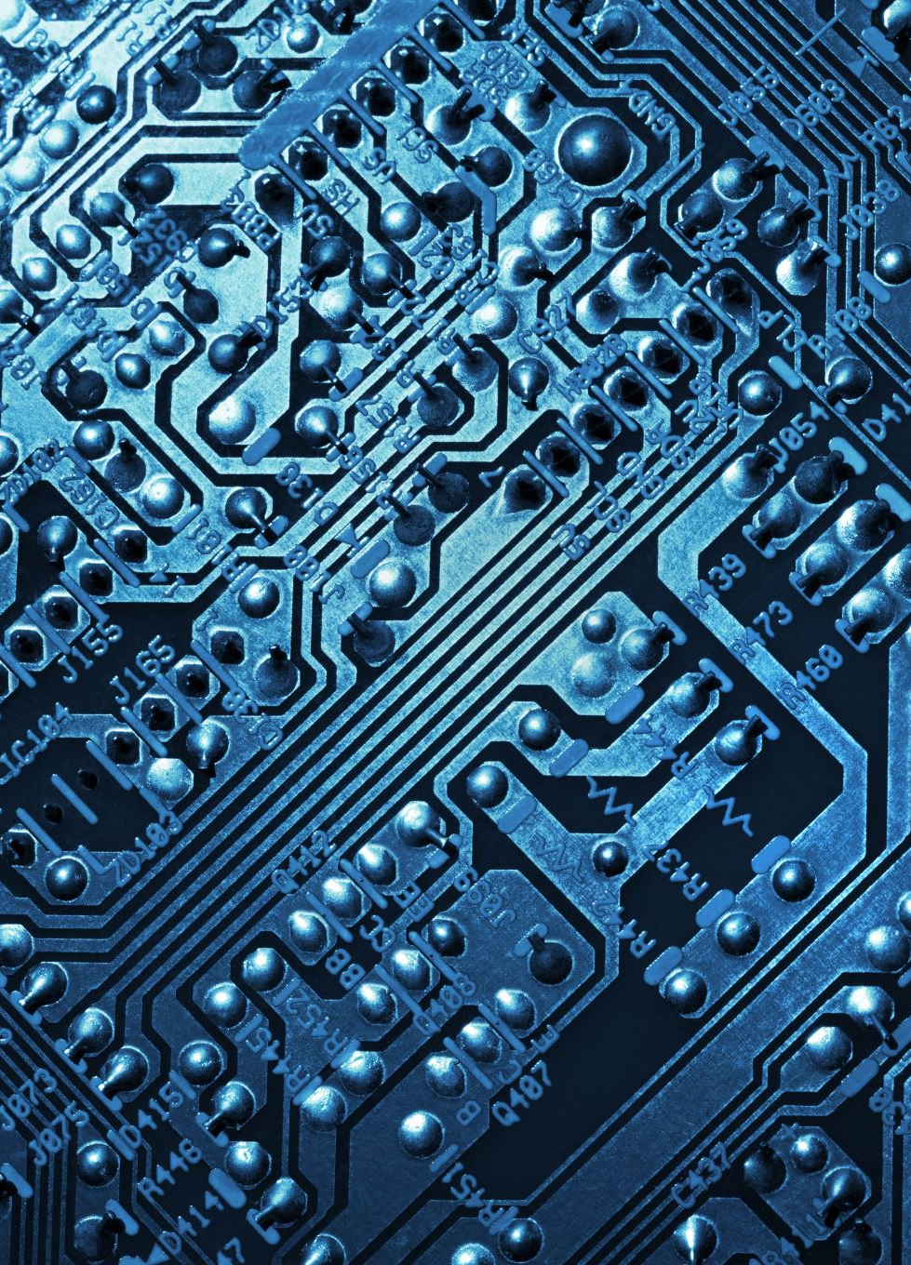
Digital Signal Processing
Presented By:
Dr. Pratosh Kumar Pal

